Slide 1
A Geovisual Framework with Open Data for Novice Users
Michael Crowder
Lauren Darr
Gerardo Garza
Brent Allan

Slide 2
Is open data really open?
Open data should mean that data is open and available
While data is available is it really open to the public?

Slide 3
Is open data really open?
Open data should mean that data is open and available
While data is available is it really open to the public?
Is open data really open at all?
Yes and no
Does the public know what or how to use
Comma-separated values (.csv)
JavaScript Object Notation (JSON)
Application Programming Interface (API)

Slide 4
Is open data really open?
Not solving it today

Slide 5
Motivation behind Geovisual Framework
Two phase motivation
Open Data – data that is freely available for use and redistribution by anyone for any purpose. http://opendatahandbook.org/glossary/en/terms/open-data/

Slide 6
Motivation behind Geovisual Framework
Two phase motivation
Open Data – data that is freely available for use and redistribution by anyone for any purpose. http://opendatahandbook.org/glossary/en/terms/open-data/

Slide 7
Motivation behind Geovisual Framework
Two phase motivation
National Incident-Based Reporting System (NIBRS)
New crime reporting standard starting in 2021
Allows up to 10 offenses per incident
Higher level detail on less serious crimes

Slide 8
Motivation behind Geovisual Framework
Two phase motivation
National Incident-Based Reporting System (NIBRS)
New crime reporting standard starting in 2021
Allows up to 10 offenses per incident
Higher level detail on less serious crimes

Slide 9
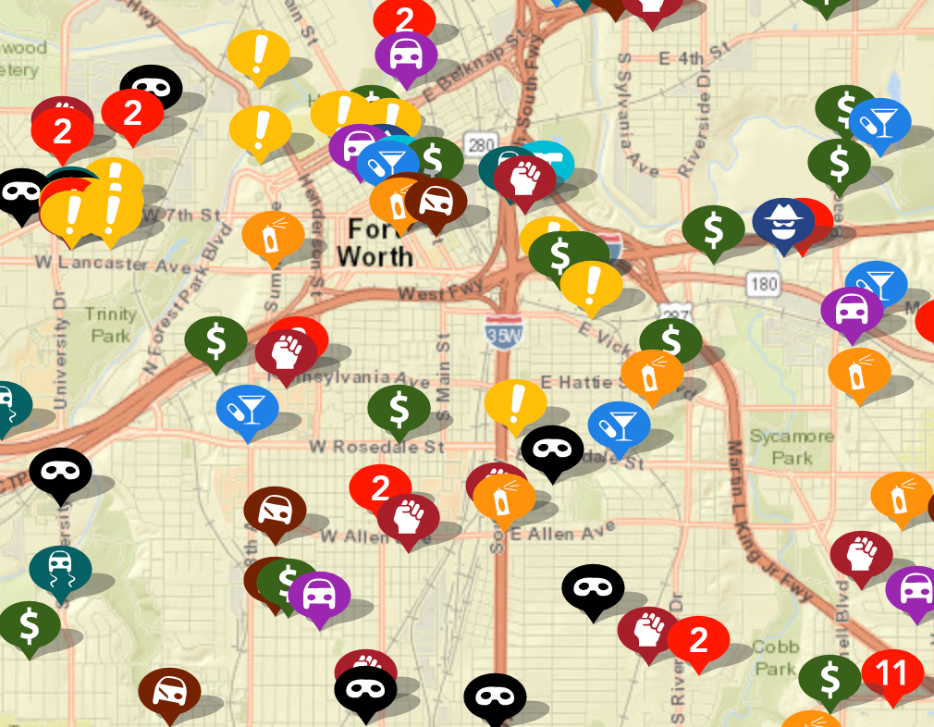
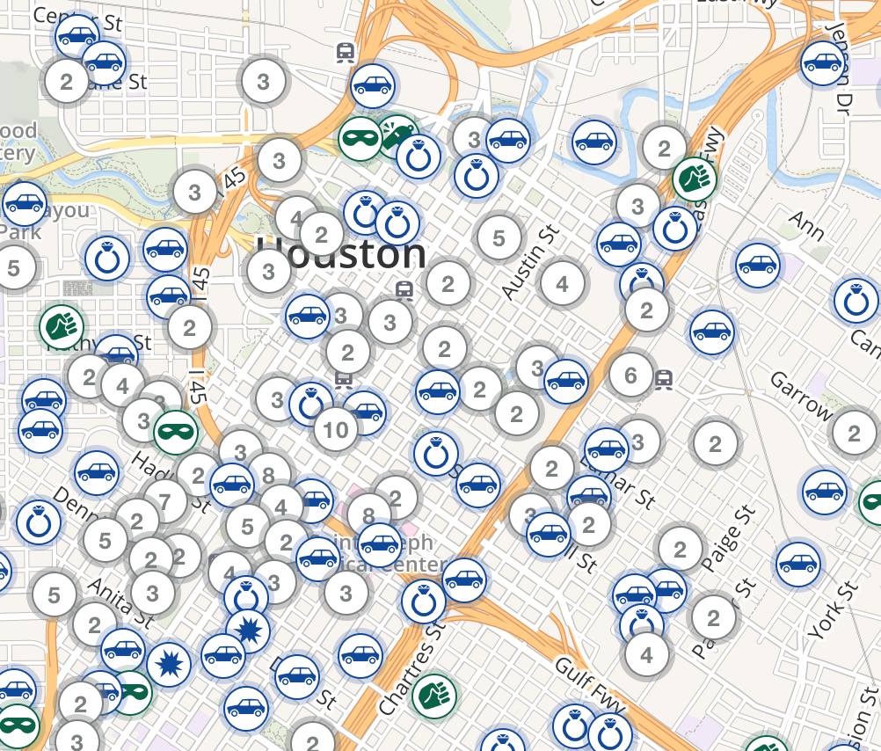
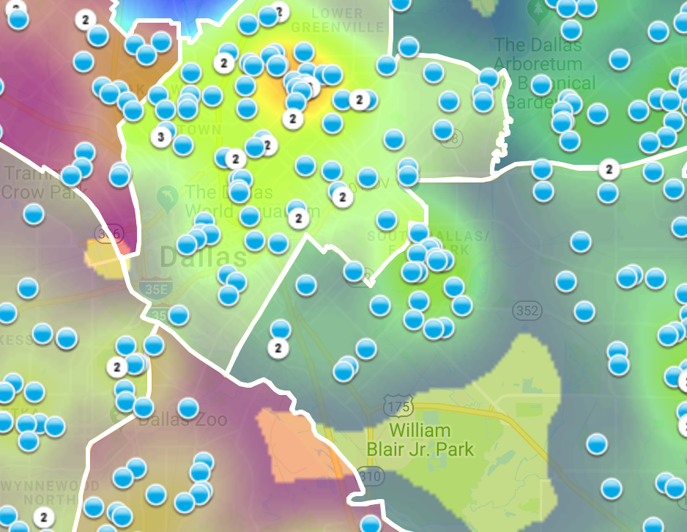
Motivation behind our Geovisual Framework
Currently, no standards exist for geovisual framework to display criminal activity on digital maps.
https://www.crimemapping.com/
https://www.crimereports.com
https:www.cityofirving.org

Slide 10
Data Source
Data source
City of Dallas Open Data Portal
Police Incident Data
386K Rows
103 Columns
2015 - 2018
Our mapping focuses on burglaries
Ability to segment
Not an overwhelming number like breaking into cars

Slide 11
Data Source
Data source
City of Dallas Open Data Portal
Police Incident Data
386K Rows
103 Columns
2015 - 2018
Our mapping focuses on burglaries
Ability to segment
Not an overwhelming number like breaking into cars

Slide 12
Map Making
Mapping handled through open-source products
R
Leaflet – Open-source JavaScript library

Slide 13
Map Making
Mapping handled through open-source products
R
Leaflet – Open-source JavaScript library

Slide 14
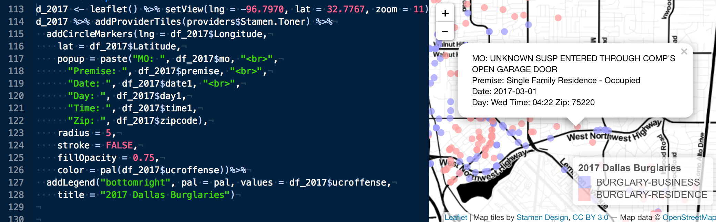
Map Making
Mapping handled through open-source products
R
Leaflet – Open-source JavaScript library

Slide 15
Intro to framework

Slide 16
Intro to framework

Slide 17
Intro to framework

Slide 18
Intro to Framework

Slide 19
Geovisual Framework

Slide 20
Geovisual Framework

Slide 21
Time

Slide 22
Time

Slide 23
Interactivity

Slide 24
Interactivity

Slide 25
Color

Slide 26
Color

Slide 27
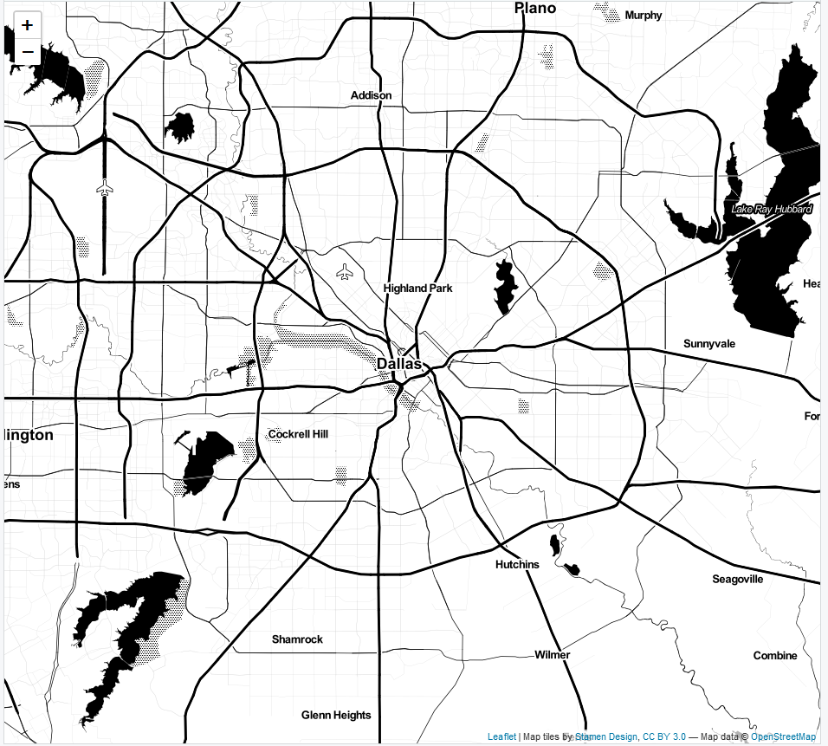

Basemaps
Zoom: ‘11’
Zoom: ‘16’
Leaflet, 3rd party, or custom map tiles
Landscape of chosen design and detail
Layering capability
2-lines of code

Slide 28
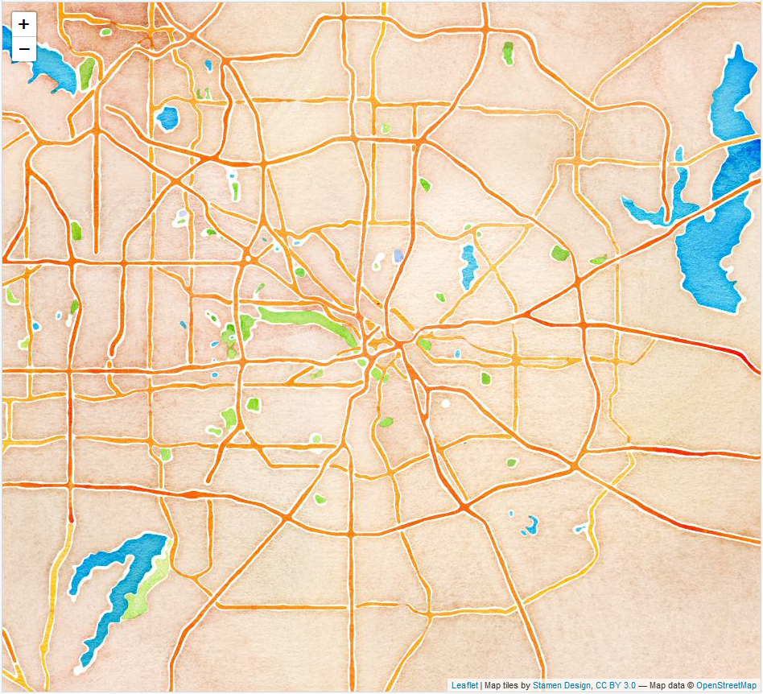
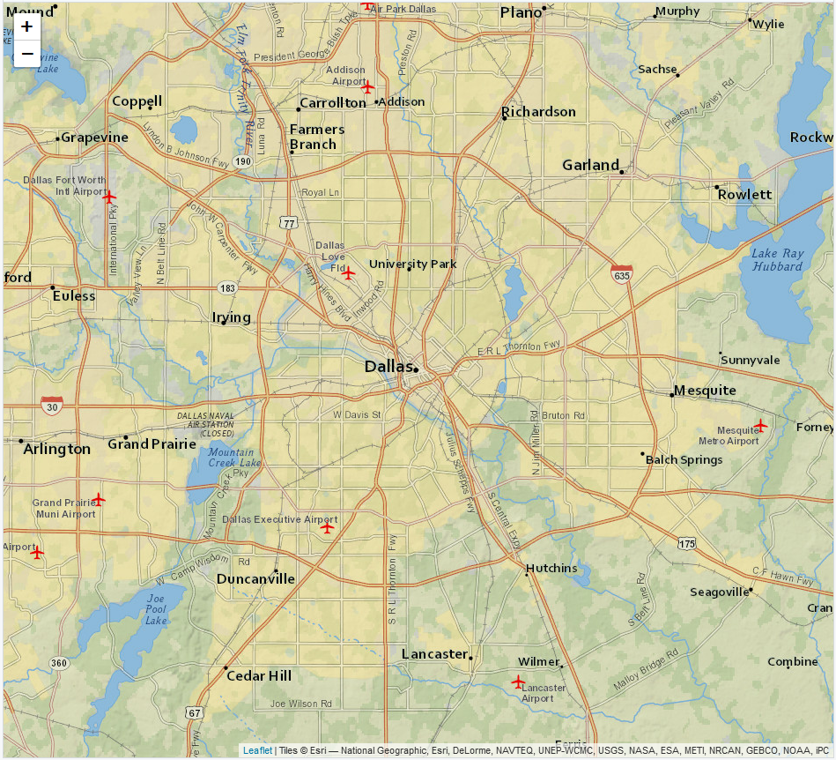
Basemaps
Artistry v. Clarity
Watercolor
Zoom: ‘11’
NatGeo
Zoom: ‘11’

Slide 29
Map Types
Dot Map
Discrete, multiple variables
View of landscape
Dot size can be misleading
Opacity for density
*Map examples*

Slide 30
Map Types
Dot Map
Map examples

Slide 31
Map Types
Cluster Map
Solution to densely populated dot map
Mouse over feature
‘Spiderfy’ shows individual objects on zoom
Computationally more efficient than dot

Slide 32
Map Types
Cluster Map
*Map examples

Slide 33
Map Types
Heat Map
Density, higher level view
Heat v. Hot Spot important distinction
Single variables

Slide 34
Map Types
Heat Map
*Map examples

Slide 35
Variable Selection
# NIBRS Incident types
Can’t display all variables at once
What are most useful for citizens?
Careful to choose several together

Slide 36
Variable Selection
*Examples

Slide 37
Deployment & Conclusion

Slide 38
Deployment & Conclusion

Slide 39
Deployment & Conclusion

Slide 40
Deployment & Conclusion

